Slide 1


Sideband Inversion, Carrier Suppression and all that...
Note: This is only applicable if you are designing your own Superhet Radio.
Kits and commercial radios account for sideband inversion

Slide 2
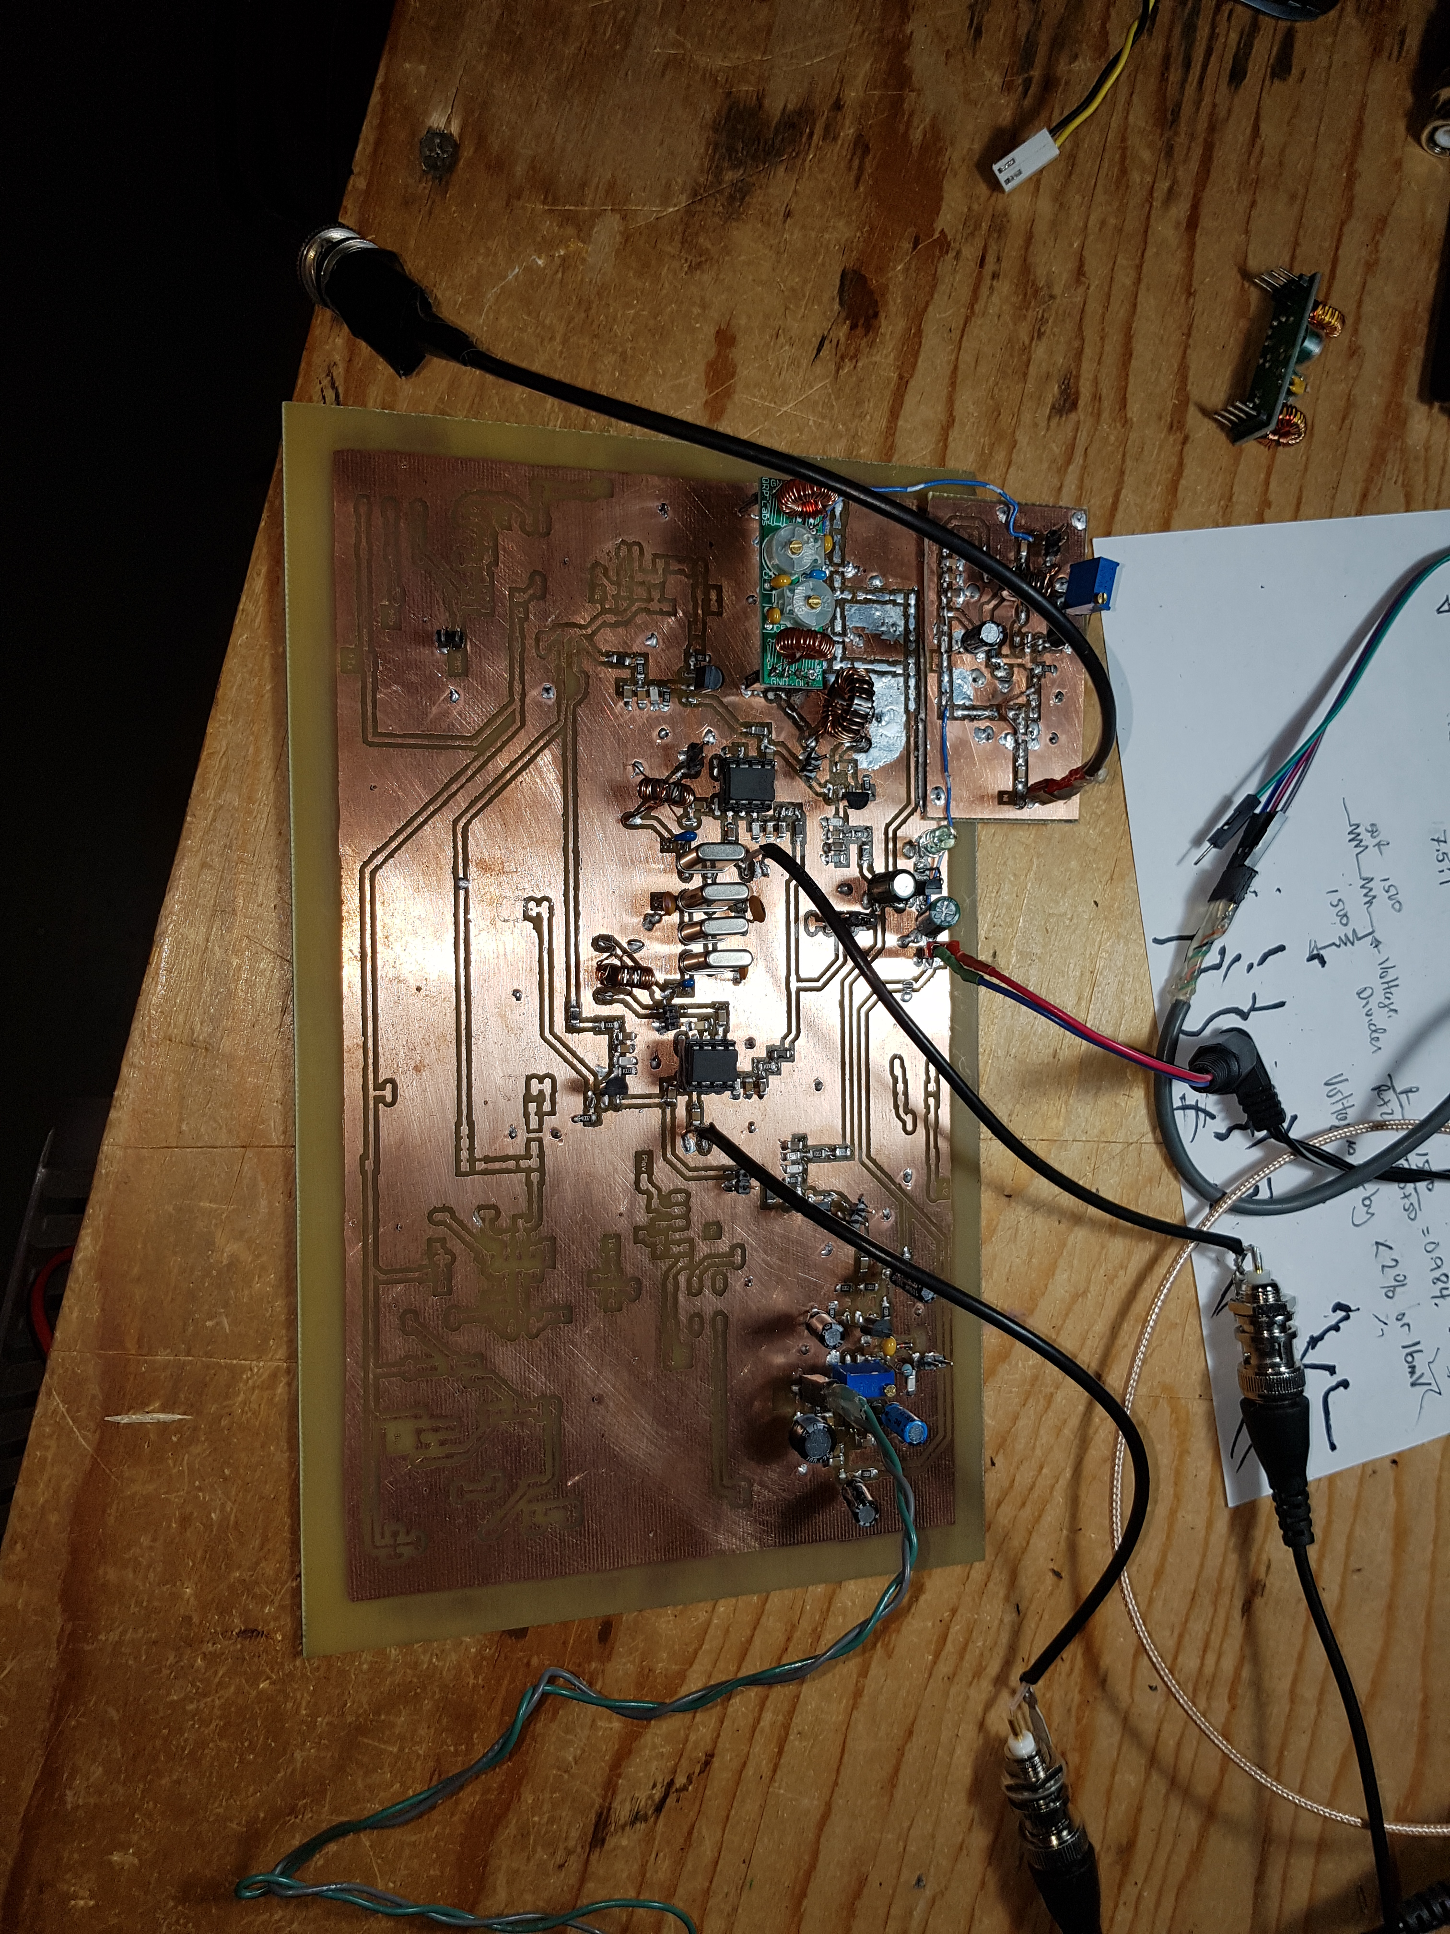
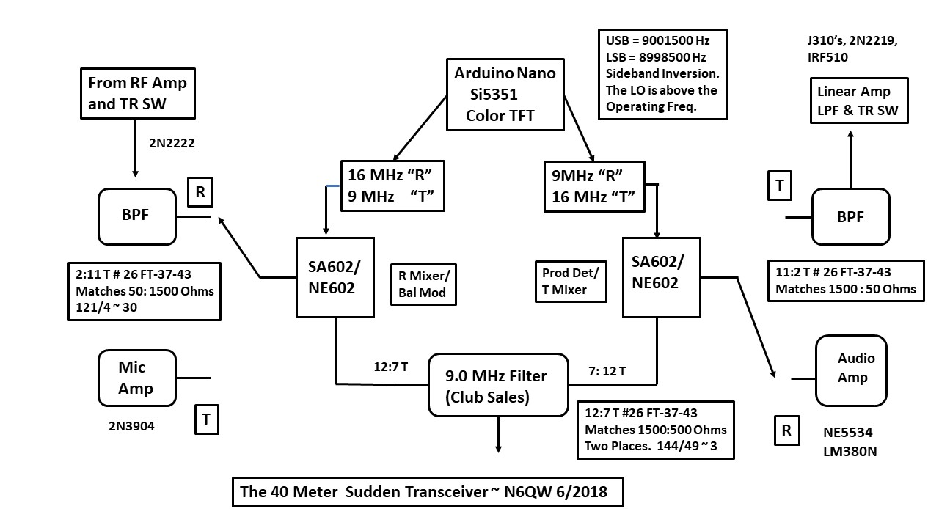
How it Started?
Modified for Multiband and 12 MHz IF
Dueling 612’s Transceiver

Slide 3
SIDEBAND INVERSION
Sometimes referred to as spectrum inversion
Swapping of LSB (Lower Side band) and USB (Upper Side Band) depending on how mixing is done
High Side Injection: Happens when LO (Local Oscillator) frequency is higher than incoming RF (Radio Frequency) input signal. Alternatively, IF (Intermediated Frequency) is lower that LO
i.e., LO > RF, or IF < LO
You could start out with an UPPER sideband signal coming out of your sideband generator, then, after you mix it with your VFO (or Si5351!) you end up with a LOWER sideband signal.
Bill Meara, N2CQR
Sideband reversal occurs in mixing only if the signal with the modulation is subtracted from the signal that isn't modulated.
Joel Hallas, W1ZR

Slide 4
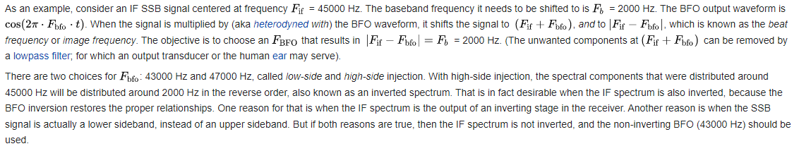
Wikipedia Says….

Slide 5

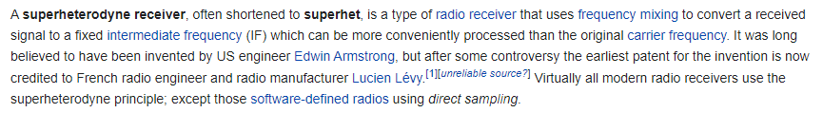
BACK TO BASICS: SUPERHETERODYNE RECEIVER
Bandwidth
Filter
Mixer
Mixer
RF
IF
Audio
Used for Selectivity
LO
BFO
Mix incoming radio frequency (RF) signal (from Antenna) to an intermediate frequency (IF)
Use filter to limit bandwidth and improve selectivity
E.g., bandwidth of 700 Hz for CW, 3KHz for SSB

Slide 6

BACK TO BASICS: SUPERHETERODYNE TRANSMITTER
Bandwidth
Filter
Mixer
Mixer
Audio
IF (RF)
RF
Used to supress carrier and unwanted sideband
Carrier
LO
Mix/Modulate incoming audio signal (microphone) with a carrier (Oscillator) to an intermediate frequency (IF) which is RF
Filter IF to only pass desired sideband (i.e., supress carrier and other sideband)
Limit bandwidth to be transmitted
Mix IF with another Oscillator to generate desired RF to antenna

Slide 7
BACK TO BASICS: MIXING
Fin
Fout
Fosc
Fout = m x Fosc +/- n x Fin (for all m & n)
That is,
Fout = m x Fosc – n x Fin
Fout = m x Fosc + n x Fin
m and n represents harmonic number (1st harmonic, 2nd harmonic, etc.)
Let's only consider the fundamental frequency
Let's assume m=1 and n=1
Fout₁ = Fosc – Fin
Fout₂ = Fosc + Fin

Slide 8
CONVENTION
From here on I will be discussing frequency domain. It’s the output in a spectrum analyzer
In the time domain, we use an Oscilloscope which does not distinguish multiple frequencies
This is showing 3 distinct frequencies present in the signal
SA display each frequency as a line (i.e., pure sine wave)
Frequency
F₁
F₂
F₃

Slide 9
BACK TO BASICS: GENERATING SIDE BANDS
Fa
Fmd
Fa = Audio Frequency (e.g., 1500 Hz)
Frf or Fc = Radio Frequency Carrier (e.g., 7.1 MHz)
Fmd= Modulated Radio Frequency output
THIS IS VERY IMPORTANT!!
Frf or Fc
Let's mix (modulate) a carrier radio frequency (e.g., 7.1 MHz) with an audio frequency (e.g., 1500 Hz). Remember m=n=1 i.e., Fundamental only
Fmd = Frf + Fa = Fc + Fa (USB)
Fmd = Frf – Fa = Fc – Fa (LSB)
E.g.
Fc + Fa (USB) = 7100000 + 1500 = 7101500 Hz
Fc – Fa (LSB) = 7100000 - 1500 = 7098500 Hz
Note: USB and LSB are identical and can be interchanged
Fc
Fc - Fa
Fc + Fa
Frequency
LSB
USB

Slide 10
SIDEBAND WITH AUDIO
Fc
Fa
Fc - Fa
Fc + Fa
High Frequency Audio (say 3KHz)
Low Frequency Audio (say 100Hz)
Frequency
LSB
USB
LSB is a reflection of USB and this is important when selecting BFO
!!
Fc
THIS IS VERY IMPORTANT!!
Fc - Fa
Fc + Fa
i.e., USB and LSB are identical but a mirror image
Fa
LSB
USB
RF Frequency
Audio Frequencies
High Frequency Audio
(Farther from Carrier)
High Frequency Audio
(Farther from Carrier)
Low Frequency Audio
(Closer to Carrier)

Slide 11
SINGLE SIDEBAND SUPRESSED CARRIER TRANSMISSION
Carrier Suppressed
Fc + Fa
Low Frequency Audio
High Frequency Audio
USB
RF Frequency
LO
LO
Placing LO on wrong side (and subtracting) will invert the audio.
Fc + Fa
Low Side Injection
High Side Injection
USB
RF Frequency
Low Frequency Audio
(Closer to Carrier)

Slide 12
LET'S BREAK IT DOWN

Slide 13
FIRST MIXER: GENERATE IF
Frf
Fif
Frf = Radio Frequency input (modulated carrier suppressed)
Flo = Local Oscillator Frequency
Fif = Intermediate Frequency
Flo
Recall for m=n=1, a mixer generates two frequencies:
Fif = Flo + Frf
Fif = Flo - Frf
Sideband inversion is only when LO is higher than RF or IF (i.e., LO > RF, or LO > IF)
If LO > RF, Need to subtract RF from LO to get IF
Fif = Flo - Frf
Fif = Flo + Frf (unwanted image)
If LO < RF, No inversion even if you subtract
Fif
(Image)
Fif
Frf
Flo
Frequency
IF somewhere below LO

Slide 14
FIRST MIXER: GENERATE MODULATED IF
Fmd
Fif
RF from
Antenna
Recall, for modulated carrier
Fmd = Fc + Fa (USB)
Fmd = Fc - Fa (LSB)
If we inject Fmd into mixer, what is the IF.
Fif = Flo + Fmd
Fif = Flo - Fmd
Only focus on subtraction part of mixed artifact
Fif = Flo – (Fc + Fa) (USB)
Fif = Flo – (Fc - Fa) (LSB)
Expand and you get
Fif = Flo – Fc - Fa (was USB)
Fif = Flo – Fc + Fa (was LSB)
Buf Fif = Flo – Fc and so
F₁ = Fif - Fa (now LSB, was USB)
F₂ = Fif + Fa (now USB, was LSB)
See
Slide 9
Flo
Fmd = Modulated Radio Frequency input (carrier supressed LSB/USB)
Flo = Local Oscillator Frequency
Fif = Intermediate Frequency
Fa = Audio Frequency that modulates carrier
Fif - Fa
Fif
Fif + Fa
Flo
Frequency
Was USB now LSB after mixing
Was LSB now USB after mixing

Slide 15
ALTERNATE VIEW
Low Frequency Audio
High Frequency Audio
Fmd
Fif
Fmd = Modulated Radio Frequency input (modulated)
Flo = Local Oscillator Frequency
Fif = Intermediate Frequency
USB
Flo
Flo
Flo
Fc
High Frequency Audio
Low Frequency Audio
Fif
EQUALS
High Frequency Audio
Low Frequency Audio
MINUS
USB
LSB
Frequency
100
10
20
80
90

Slide 16
ADDRESS IN TRANSMIT CHAIN

Slide 17
CARRIER SUPRESSION: Why is Sideband Inversion Important?
Fc
Fc - Fa
Fc + Fa
Frequency
LSB
USB
Need to remove the carrier and only select USB or LSB when receiving or transmitting
Answer: All radios transmit USB and LSB and not the inverted sideband….How do you to this?
Fc
Fc - Fa
Fc + Fa
LSB
USB
Frequency
Low Frequency Audio
Low Frequency Audio

Slide 18
THE BANDWIDTH FILTER (Crystal Filter) Transmitter
Bandwidth
Filter
Mixer
Mixer
Audio
IF₁
IF₂
Radio Frequency
Carrier
LO
Fc
Filter Passband
Fc - Fa
Fc + Fa
Fc + Fa
LSB
USB
USB
IF1
IF2

Slide 19
THE BANDWIDTH FILTER (Crystal Filter) Transmitter
Crystal Filter Centre Frequency
(Resonant Frequency of Filter)
E.g., 4914507 Hz
Fc equal to Filter centre frequency
Fc shifted 1500 Hz BELOW Filter centre frequency
Fc
Fc
Fc - Fa
Fc + Fa
Fc - Fa
Fc + Fa
LSB
USB
LSB
USB

Slide 20
THE BANDWIDTH FILTER (Crystal Filter) Transmitter
If LO is higher than IF₂, Sideband will be inverted.
i.e., RF=LO-IF₂
Bandwidth
Filter
Mixer
Mixer
Audio
IF1
IF2
Radio Frequency
Carrier
LO
Fc shifted 1500 Hz ABOVE Filter centre frequency
Fc
To get proper orientation, need to “invert” Carrier.
Filter USB to transmit LSB.
Filter LSB to transmit USB
Fc - Fa
Fc + Fa
LSB
USB

Slide 21
ADDRESS IN RECEIVE CHAIN

Slide 22

The Bandwidth Filter (Crystal Filter) RECEIVER
Bandwidth
Filter
Mixer
Mixer
Filter Centre Frequency to only pass USB
Mixer shifts incoming RF to be within the filter passband
Need to shift Fc + centre of USB
RF
IF
Audio
LO
BFO
Fc
Fc
Fshift
Fc + Fa
USB
USB
RF
IF
WHAT COULD HAPPEN HERE?
Sideband Inversion

Slide 23
The Bandwidth Filter (Crystal Filter) RECEIVER
Fc
Fc
Fshift
Fc + Fa
USB
LSB
RF
IF
LO
If LO above RF, the 1st Mixer inverts sideband
i.e., IF = LO - RF
USB input to mixer
LSB output from the mixer
Note: USB and LSB are identical and can be interchanged

Slide 24
The Bandwidth Filter (Crystal Filter) RECEIVER
Mixer
IF
Audio
High Frequency Audio
BFO
High Frequency Audio
Low Frequency Audio
Low Frequency Audio
Fbfo
Fbfo
Fc + Fa
Fbfo needs to be below or above signal in order to get low/high frequency orientation
Need to account for sideband inversion when determining BFO frequency
e.g., LSB, Fbfo = Filter Centre frequency + 1500 Hz
e.g., USB, Fbfo = Filter Centre frequency - 1500 Hz
USB
LSB
RF
IF

Slide 25

Ya gotta ask yourself one question
Do you know what causes sideband inversion and how to deal with it?
Well…Do ya punk?

